Slide 1
COMP 225-hybrid: Software Engineering Methodologies Software Requirements Specification (SRS)
The Lyricist
Presented by:
Rohaan - 301372121 Kuan-Wei - 301287850 Julian - 301411214 Joshua - 301350618 Hoang Giang - 301255147 Date : April 10, 2024
Section : 011
Semester : Winter
Notes:
Instructions:
Customize the black text. Be sure to include the names of all team members.

Slide 2
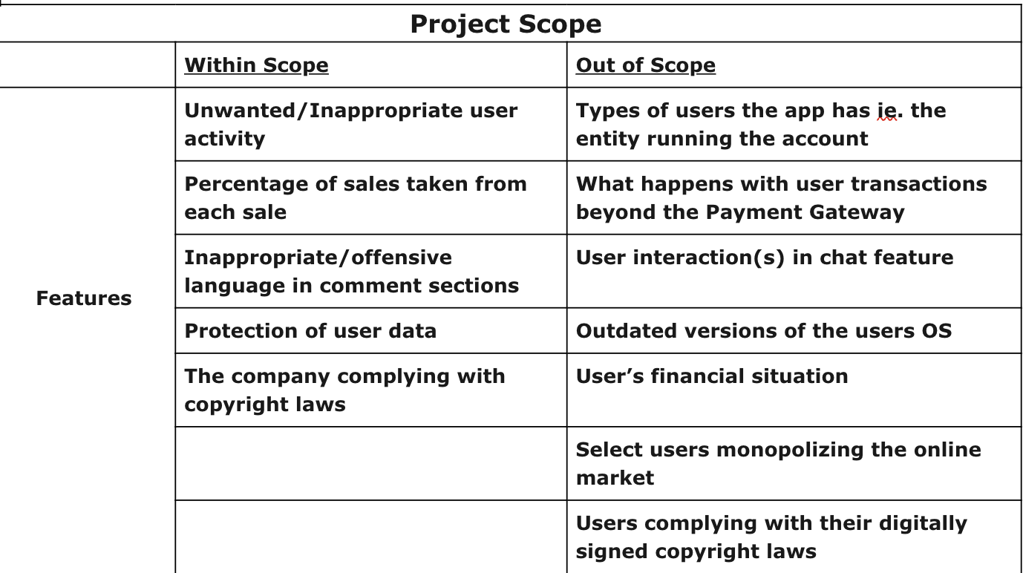
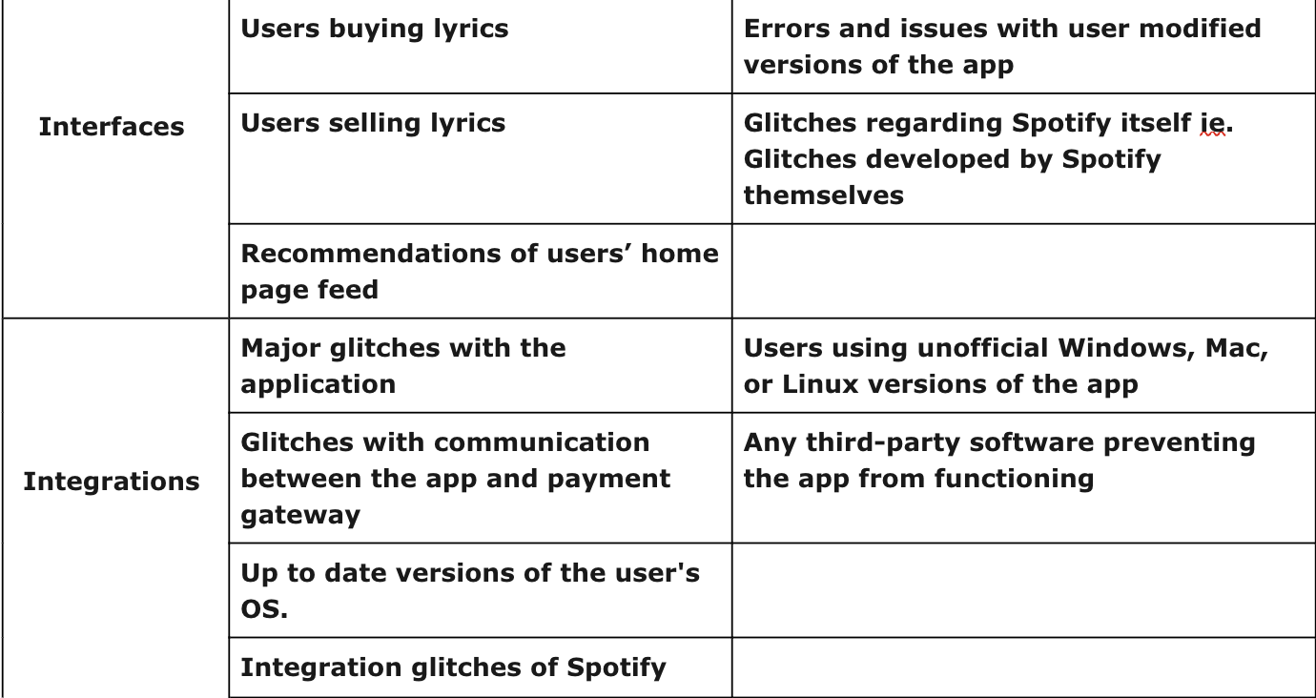
Introduction
Purpose
The “Lyricist” is a new software that will be beneficial for both songwriters and singers.
It allows songwriters to sell their original lyrics and transfer the rights to the singers who purchase them.
The transaction will be secured by a legal document that will grant the singer exclusive ownership of the lyrics. The app will release version will 1.0.0.
Project scope
Notes:
Instructions:
Keep it direct to the point, take onboard any feedback you got from Part A

Slide 3
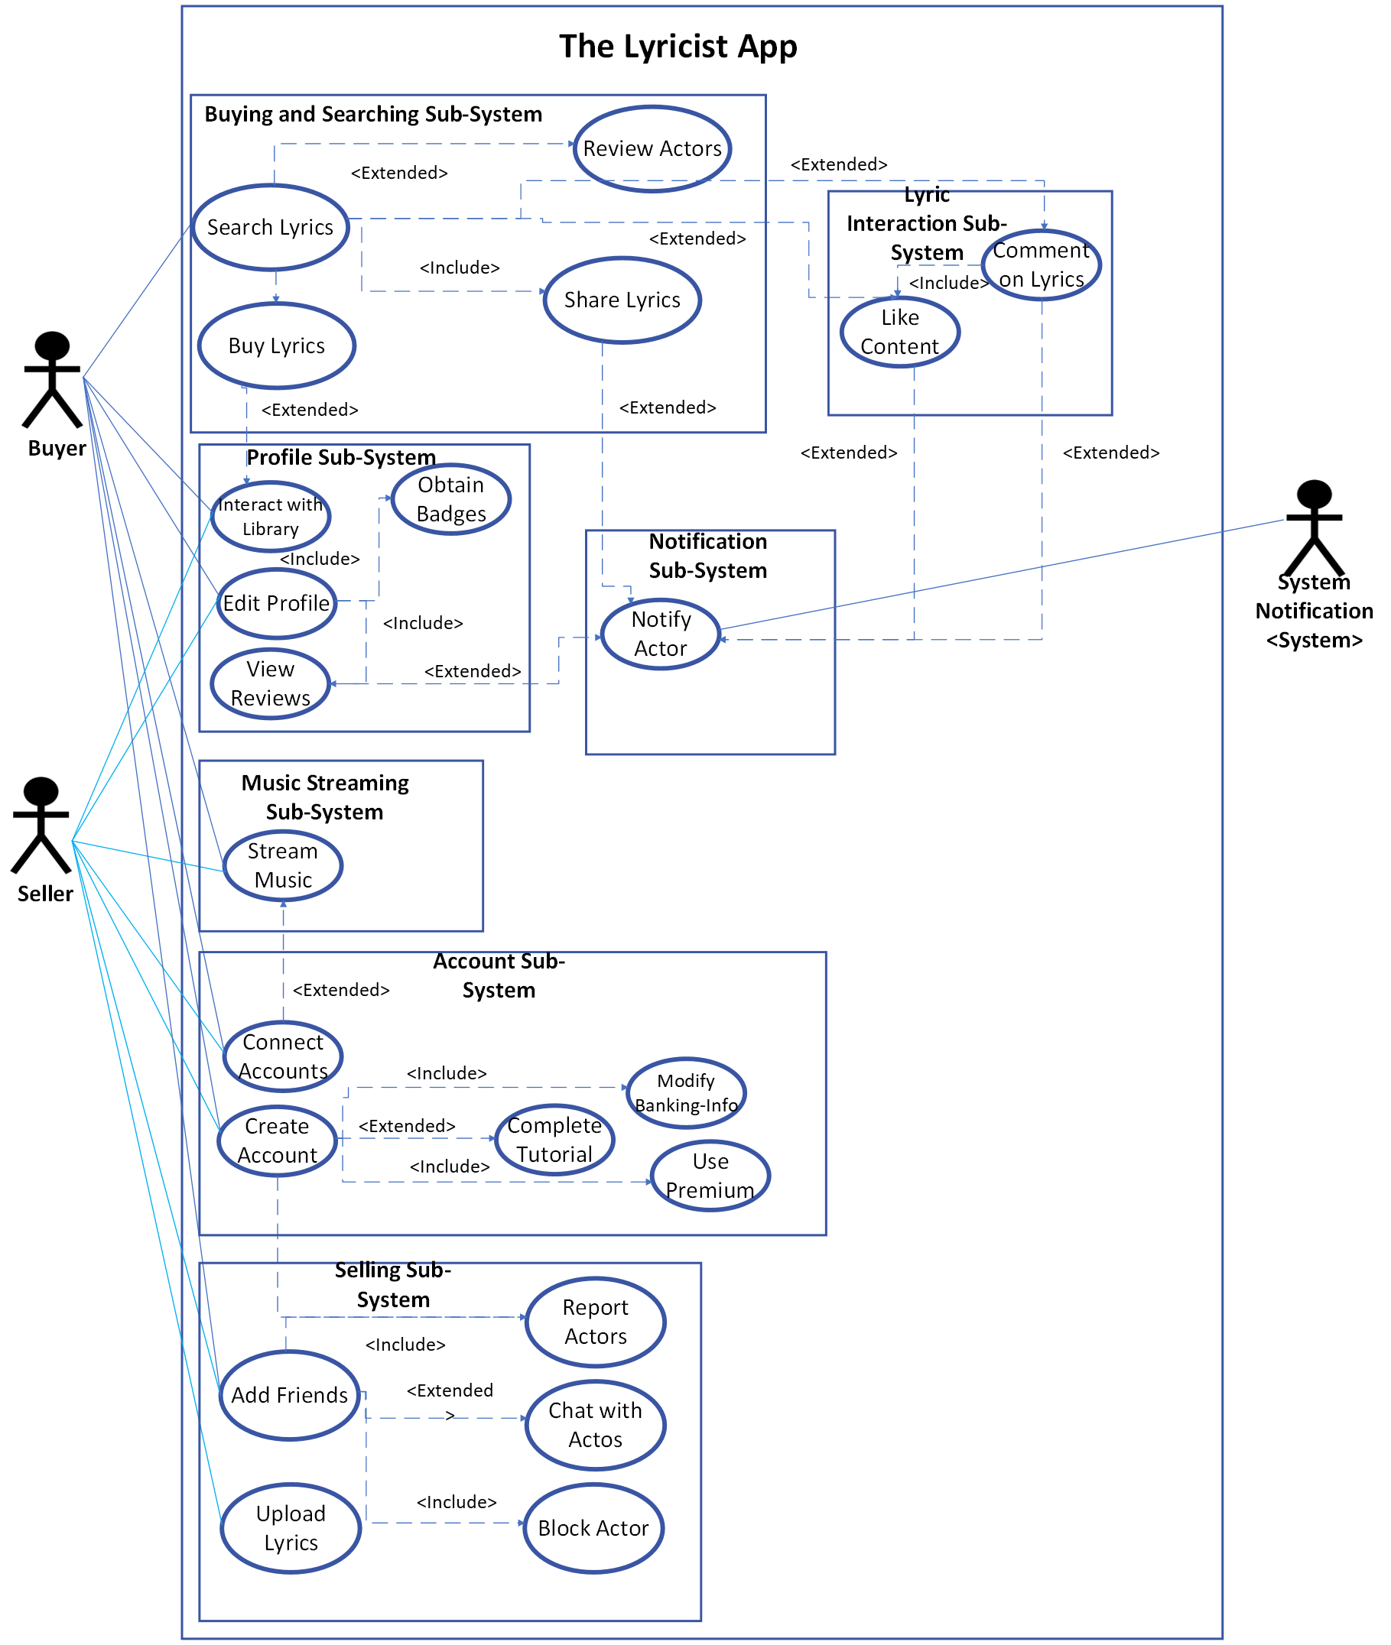
Packaged Use Case Diagram
Notes:
Instructions:
The use case diagram should show all the actors and the sub-systems

Slide 4
Use Cases Brief Descriptions
Goal Use Case name | Actors | Use Case Brief Description
1.Upload Lyrics | Song Writers, Artists, Sellers | The actor (Sellers) will open a new UI and fill in the following fields: Lyric Title, language, song file (txt, word, etc.), full name, Phone Number, Email, and Cost of the lyric and any other users involved in the lyric; the user will then be asked to enter their password and after entering their password, press submit lyric. The actor will see a message saying the lyrics have been uploaded.
2. Search Lyrics | Artist, Songwriter, Singer, Buyers, Sellers | The actor (All) will type a song name, artist, or keywords and select the available search tags, and finally press enter. The actor will then see up to 5 lyric listings that relate to their input search and filters on their screen and will scroll up to view more lyric listings.
3. Stream Music | Artists, Songwriter, Singer, Buyers, Sellers, Song Listeners, Spotify Users | The actor (All) will press the Spotify logo in the top left of their screen, the actor then will see a similar UI to the Spotify app. The actor will click their desired song, playlist, album, or artist and click the play button to listen to their selected music.
4. Modify Banking-Info | Artists, Songwriter, Singer, Buyers, Sellers | The actor (All) will open their account settings and press either update, remove, or add banking info. When clicking add or update, the actor will enter their new banking info, and press submit.
5. Buy Lyrics | Artists, Singers, Producers, Buyers | The actor (Buyers) will select a lyric listing and view the details of the listing. The actor will then press ‘Buy Lyric’, the actor will enter their banking info (if not provided previously) the actor will then read and sign the legal document then they will enter their password and press ‘submit order’ the actor will then get the new lyric in their lyric library.
6. Add Friends | Artists, Songwriter, Singer, Buyers, Sellers, Song Listeners | The actor (All) will open the other actor's profile and press the add friend button and the actor will then see the other actor in their feed more often and can message the other actor as well.
Notes:
Instructions:
List the top six use cases. In your brief description focus on what system response is to user actions

Slide 5
Use Case Full Description
Use case name | Searching Lyrics
Iteration | 1, last modification: February 27 by H. Giang Dang
Primary Actor | Buyer
Goal in context | The buyer searches for their desired lyrics and finds what the buyer is looking for.
Trigger | The buyer decides to search for lyrics and purchase.
Scenario | The buyer opens the “Lyricist” app. The app displays the home page and primary menu at the bottom of the screen. The buyer click the magnifying glass icon. The buyer hit the “Search here” bar. The buyer’s digital keyboard slides up. The buyer types in their desired search. The app shows numerous lyric listings. The buyer scrolls through the lyric listings. The buyer selects their desired lyric listing. The app displays the details of the lyric listing.
Exceptions | 1.No search results found: If the buyer's desired search yields no results, the app should handle and display an appropriate message or offer alternative suggestions. 2.Technical issues: In case of technical difficulties such as server downtime or network issues, the app should provide error messages and guidance for the buyer. 3. Incorrect search results: If the search algorithm returns inaccurate or irrelevant results, the app should allow the buyer to refine their search criteria or provide feedback for improvement.
Notes:
Instructions:
Present one formal use case description, Clarify how scenario and triggering event applies to your case in addition to system flow with the user.

Slide 6
Use Case Full Description
Goal Use Cases | Searching Lyrics
Priority | Moderate priority, to be implemented after basic functions
Pre-conditions | The Buyer is registered and logged into the Lyricist app. The app has the newest deployed version of the app.
Post-conditions | The Buyer has completed their search for lyrics. The Buyer has viewed the details of the selected lyric listing and purchased
When Available | Third increment
Frequency of use | Infrequent
Channel to actor | Via app or browser and Internet connection
Secondary actors | System administrator, app
Channels to secondary actors | System administrator: PC- based system Device: Phone(app), pc(web)
Open Issues | How will the app collect and process user feedback on search results? Are there mechanisms in place for users to report inaccuracies or suggest improvements? How can the search algorithm be optimized to ensure accurate and relevant results? Are there plans for continuous improvement based on user interactions with the search feature? What specific improvements can be made to the user interface to enhance the search experience? Are there any usability issues reported by users that need to be addressed?
Notes:
Instructions:
Discuss pre-conditions and post conditions of system.

Slide 7
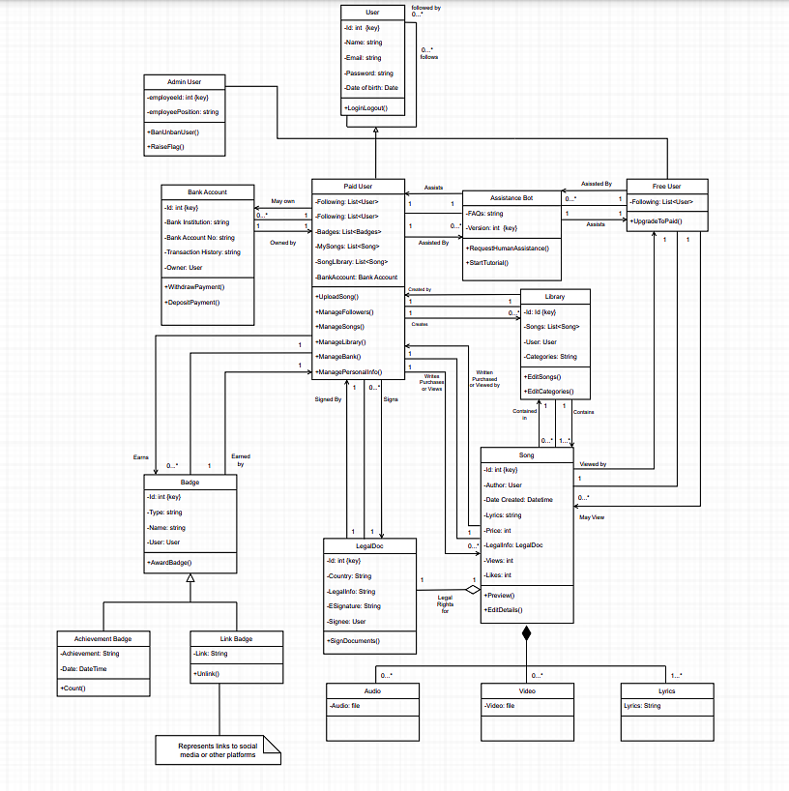
Domain Class Diagram first cut
Notes:
Instructions:
Only classes with attributes and relationships (no methods)
Discuss why you think these classes are relevant and the attributes you chose per class, also why you chose these types of associations

Slide 8
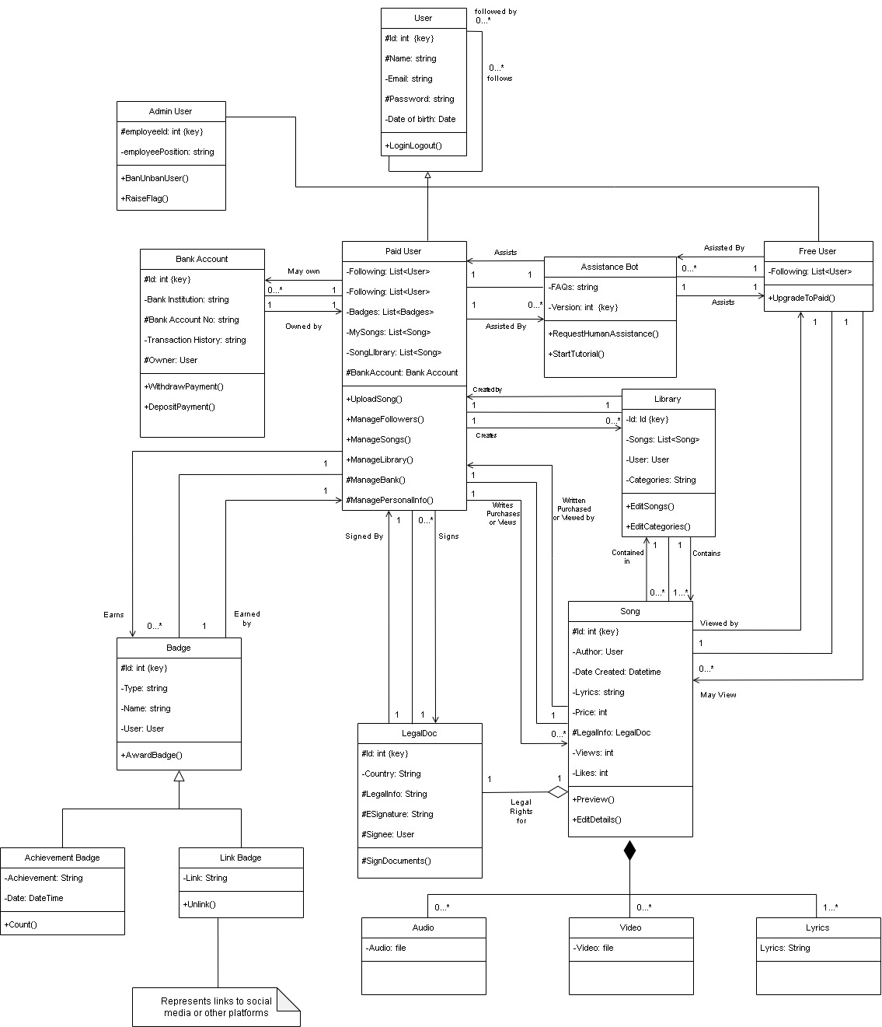
Domain Class Diagram with methods
Notes:
Instructions:
Discuss why you think these classes are relevant and the methods you chose per class, also why you chose these types of associations

Slide 9
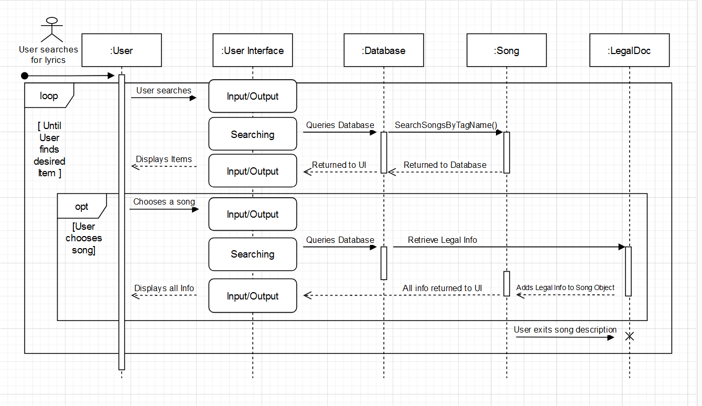
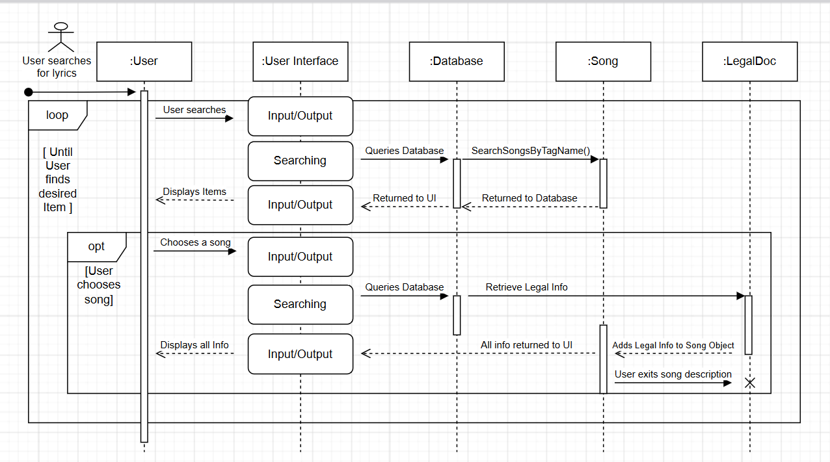
Sequence diagram
Notes:
Instructions : Mention the use case name
Set a Hyper link to launch your SD if two large
Show Input / Output messages to and from the system
Discuss why you chose it and what value does it add to the project when developers read it

Slide 10
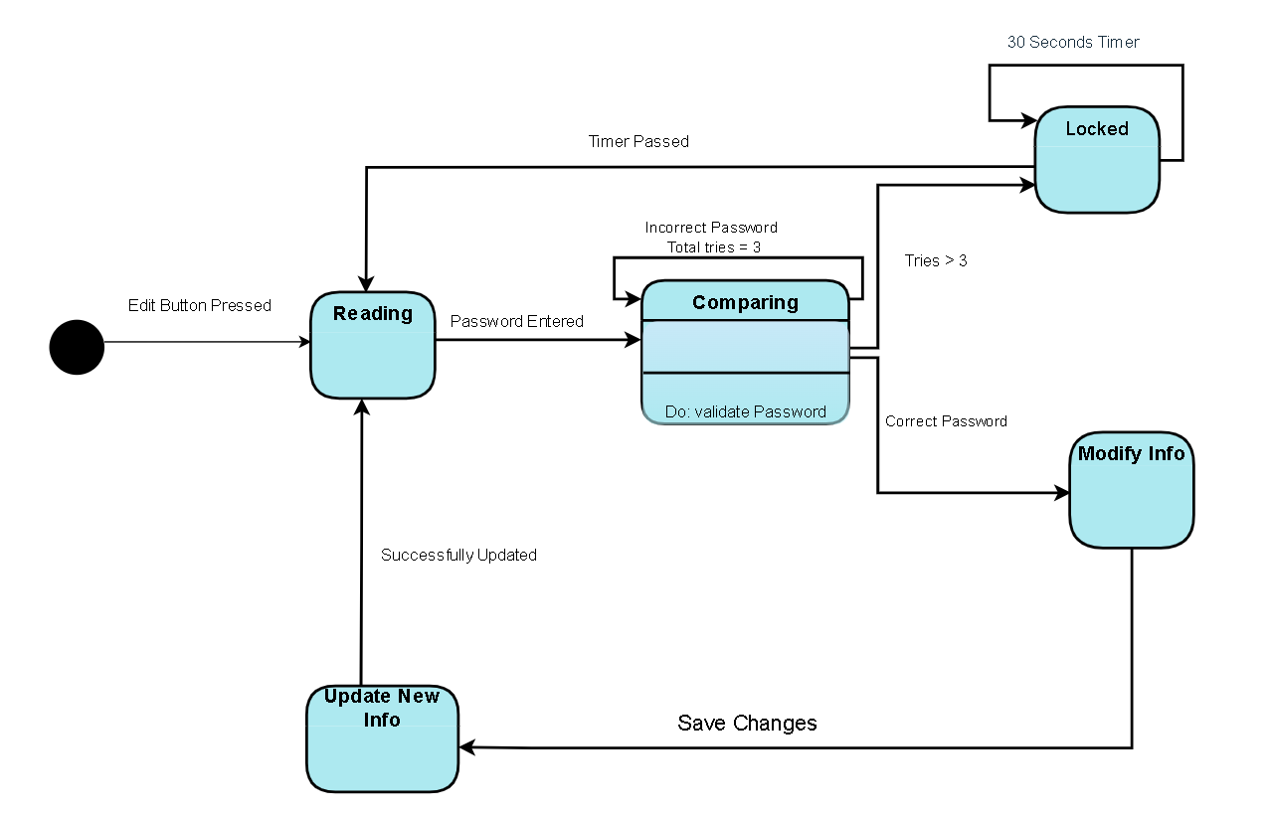
State machine diagram
Modify Banking Information
Notes:
Instructions:
Mention which object you chose.
Discuss why you chose this object and what value does the state machine diagram bring

